Slide 1
COE:
Year __ of PLL Program

Slide 2
License Period –
Utilization/Graduation Rate
Number of families that Graduated from PLL during License Period
Number of families that Dropped out during License period
Graduation Rate
Number of families Administratively Discharged during License Period
Number of Families In Process at end of License Period
Total # of families served during License Period
Total # of NEW FAMILIES served during this license period (This number does not include the 9 Carryovers (8 Graduates and 1 Drop)
Total Utilization during license period (licensed to serve 41)

Slide 3
Family Composition Demographics
21%
These statistics only include the __ Graduates and __ Drops and DO NOT INCLUDE the __ youth In Process at the end of the license period or the __ youth Administratively Discharged from the PLL Program.

Slide 4
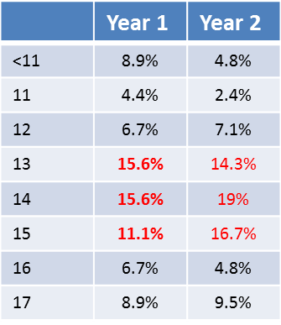
Age Demographics
31%
17.2%
10.3%
17.2%
3.4%
6.9%
6.9%
3.4%
These statistics only include the __ Graduates and __ Drops and DO NOT INCLUDE the __ youth In Process at the end of the license period or the __ youth Administratively Discharged from the PLL Program.

Slide 5
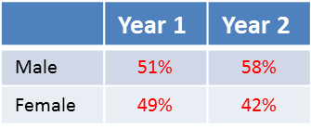
Gender Demographics
These statistics only include the 24 Graduates and 4 Drops and DO NOT INCLUDE the 23 youth In Process at the end of the license period or the 1 youth Administratively Discharged from the PLL Program.

Slide 6
Ethnicity Demographics
Ethnicity
African American | 0 | 0%
Asian | 0 | 0%
Caucasian | 0 | 0%
Hispanic | 0 | 0%
Native American | 0 | 0%
Other | 0 | 0%
Total | 0 | 100%
These statistics only include the __ Graduates and __ Drops and DO NOT INCLUDE the __ youth In Process at the end of the license period or the __ youth Administratively Discharged from the PLL Program.

Slide 7
Condition Demographics
Condition
Diversion | 0 | 0%
Foster Care | 0 | 0%
SED | 0 | 0%
Probation | 0 | 0%
Residential/Reentry | 0 | 0%
Total | 0 | 100%
These statistics only include the __ Graduates and __ Drops and DO NOT INCLUDE the __ youth In Process at the end of the license period or the __ youth Administratively Discharged from the PLL Program.

Slide 8
Youth Offense Categories
Offenses
Mischief/Misbehavior | 0 | 0%
No Charges | 0 | 0%
Illegal Possession | 0 | 0%
School Violation | 0 | 0%
Theft | 0 | 0%
Violence/Threat of Violence | 0 | 0%
Legal System Violation | 0 | 0%
These statistics only include the __ Graduates and __ Drops and DO NOT INCLUDE the __ youth In Process at the end of the license period or the __ youth Administratively Discharged from the PLL Program.

Slide 9
PLL Clinician Model Adherence Yellow = Baseline Met Green = 80% or Higher
Video Model Adherence
Therapist & Co-facilitator #1
Therapist #1 Name |  |  |  |  |  |  |  |  |  | Co-facilitator #1 Name
G1 | G2 | G3 | G4 | G5 | G6 | C1 | C2 | C3 | C4 | G1 | G2 | G3 | G4
Therapist & Co-facilitator #2
Therapist #2 Name |  |  |  |  |  |  |  |  |  | Co-facilitator #2 Name
G1 | G2 | G3 | G4 | G5 | G6 | C1 | C2 | C3 | C4 | G1 | G2 | G3 | G4
Therapist & Co-facilitator #3
Therapist #3 Name |  |  |  |  |  |  |  |  |  | Co-facilitator #3 Name
G1 | G2 | G3 | G4 | G5 | G6 | C1 | C2 | C3 | C4 | G1 | G2 | G3 | G4
Therapist & Co-facilitator #4
Therapist #4 Name |  |  |  |  |  |  |  |  |  | Co-facilitator #4 Name
G1 | G2 | G3 | G4 | G5 | G6 | C1 | C2 | C3 | C4 | G1 | G2 | G3 | G4
When all the sessions are green, this indicates the clinician has moved into the Intermediate Model Adherence Level; Sessions in Black indicate need to submit a video.

Slide 10
PLL Clinician Model Adherence
Yellow = Baseline Met | Green = Model Adherence (80% +)
Tan = Video in Queue | White = No video submitted
Video Model Adherence
Therapist Name
Group Adherence |  |  |  |  |  | Coaching Adherence
G1 | G2 | G3 | G4 | G5 | G6 | C1 | C2 | C3 | C4
(Therapist Name) is currently in the (Beginner, Intermediate, Advanced) level of Model Adherence.
When all the sessions are green, this indicates the clinician has moved into the (Intermediate, Advanced) Model Adherence Level

Slide 11
Administration of Internal Measures
 | Internal Measure | Number of Graduates | Pre- & Post-Test Sets | Percentage of Administration
Therapist #1 | Child Behavior Checklist (CBCL) | 0 | 0 | 0%
 | Youth FACES IV |  | 0 | 0%
 | Parent FACES IV |  | 0 | 0%
Therapist #2 | Child Behavior Checklist (CBCL) | 0 | 0 | 0%
 | Youth FACES IV |  | 0 | 0%
 | Parent FACES IV |  | 0 | 0%
5
Therapist #3 | Child Behavior Checklist (CBCL) | 0 | 0 | 0%
 | Youth FACES IV |  | 0 | 0%
 | Parent FACES IV |  | 0 | 0%
0
Therapist #4 | Child Behavior Checklist (CBCL) | 0 | 0 | 0%
 | Youth FACES IV |  | 0 | 0%
 | Parent FACES IV |  | 0 | 0%

Slide 12
Administration of Internal Measures
___ Families Served (__ Completers)
Internal Measure | Pre-Test | Mid-Test | Post-Test | % of Data Sets for Completers
Child Behavior Checklist (CBCL) | 0 |  | 0 | 0% (0)
Youth FACES IV | 0 |  | 0 | 0% (0)
Parent FACES IV | 0 |  | 0 | 0% (0)
Youth Readiness | 0 | 0 | 0 | 0% (0)
Parent Readiness | 0 | 0 | 0 | 0% (0)

Slide 13
Analysis of Child Behavior Checklist Pre-Post Means
PLL Treatment (n = ?)
Child Behavior Checklist (CBCL) Scales | Pre-Test Mean | Post-Test Mean | Mean Difference | t-score | Significance
Rule Breaking
Aggressive Behaviors
Internalizing Behaviors
Externalizing Behaviors
Oppositional Defiant Behavior
Conduct Disorder
Total Problems

Slide 14
Analysis of FACES IV Pre-Post Means
PLL Treatment (n = ?)
FACES IV Scales | Pre-Test Mean | Post-Test Mean | Mean Difference | T-score | Significance
Family Cohesion
Family Flexibility
Family Communication
Family Satisfaction
Family Disengaged Score
Family Enmeshed Score
Family Rigid Score
Family Chaotic Score

Slide 15
FACES IV – Family Cohesion Scale

Slide 16
FACES IV – Family Communication Scale

Slide 17
FACES IV – Family Satisfaction Scale

Slide 18
Stage of Development
Benchmarks to move along COE Stages of Development
Survival | Stable | Success | Significance
Therapist leaves in first 8 months (or new therapist has not yet reached 8 months) | No Therapist attrition in first 8 months | No Therapist attrition in first 10 months | No Therapist attrition in first 12 months
Clinical Minimum not met | Clinical Minimum Met | Clinical Minimum Met | Clinical Maximum Met (RE=30, ATP=36)
Graduation Rate Below 70% | Graduation Rate 70% or higher | Graduation Rate 75% or higher | Graduation Rate 80% or higher
Video Supervision Baseline not attained | Video Supervision Baseline Attained | Intermediate (Video) Model Adherence | Advanced (Video) Model Adherence
Administration of Internal Measures Below 80% | Administration of Internal Measures 80% or higher | Administration of Internal Measures 85% or higher | Administration of Internal Measures 90% or higher
Current Stage – Red Font Goals – Blue Font

Slide 19
Needed Improvements for Year Two
Notes:
Please note: This document will serve as a compass for your agency to determine what is concretely needed to move beyond survival mode and developmentally into the other three stages. Transportability is defined as: “The ease of which a service provider can take the concepts of the PLL model and integrate them into the real world with real families.”
All new COE's begin in the Survival Stage. To move out of Survival Stage ALL minimum measures must be met in the respective developmental stage. Example: After first year COE meets 4 out of 5 areas checked in Stable and 1 area remains unchecked in Survival. The COE will remain at Survival status.
Stages are assessed at the end of each license year. However, for new or added therapists, the COE will be given a grace period of one group cycle for the new therapists to achieve their model adherence baseline in order for a COE to remain in their Stage before moving back to Survival.

Slide 20
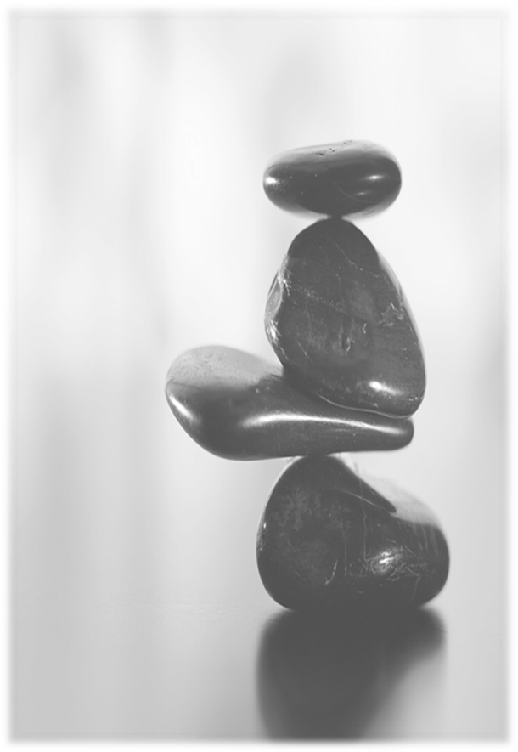
PLL Team Big Rocks
PLL Reentry Therapist
1. Review of MI Intake and rapport building
2. PLL Groups
3. Schedule family therapy sessions
4. Coaching–Phases 1-3 and Wound Work before youth returns home
5. Coaching 4 after youth returns home
PLL Case Manager
1. Initial MI Intake & administration of Pre-post- & post-posttests
2. CBAT-Monthly Meeting
3. Assist with PLL Groups
4. Attend MDT meetings and advocate for early release
5. Case Management with family through 90 days of Aftercare

