Slide 1
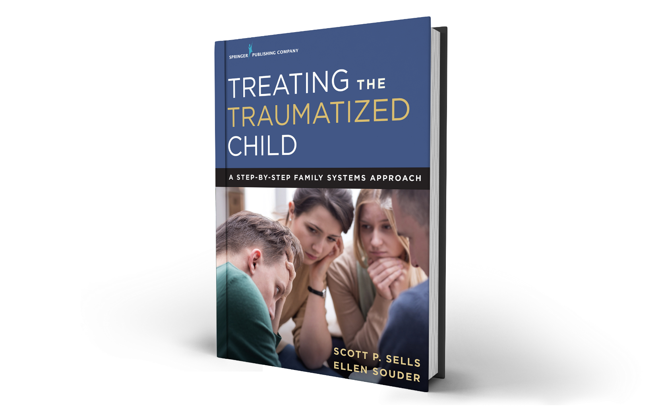
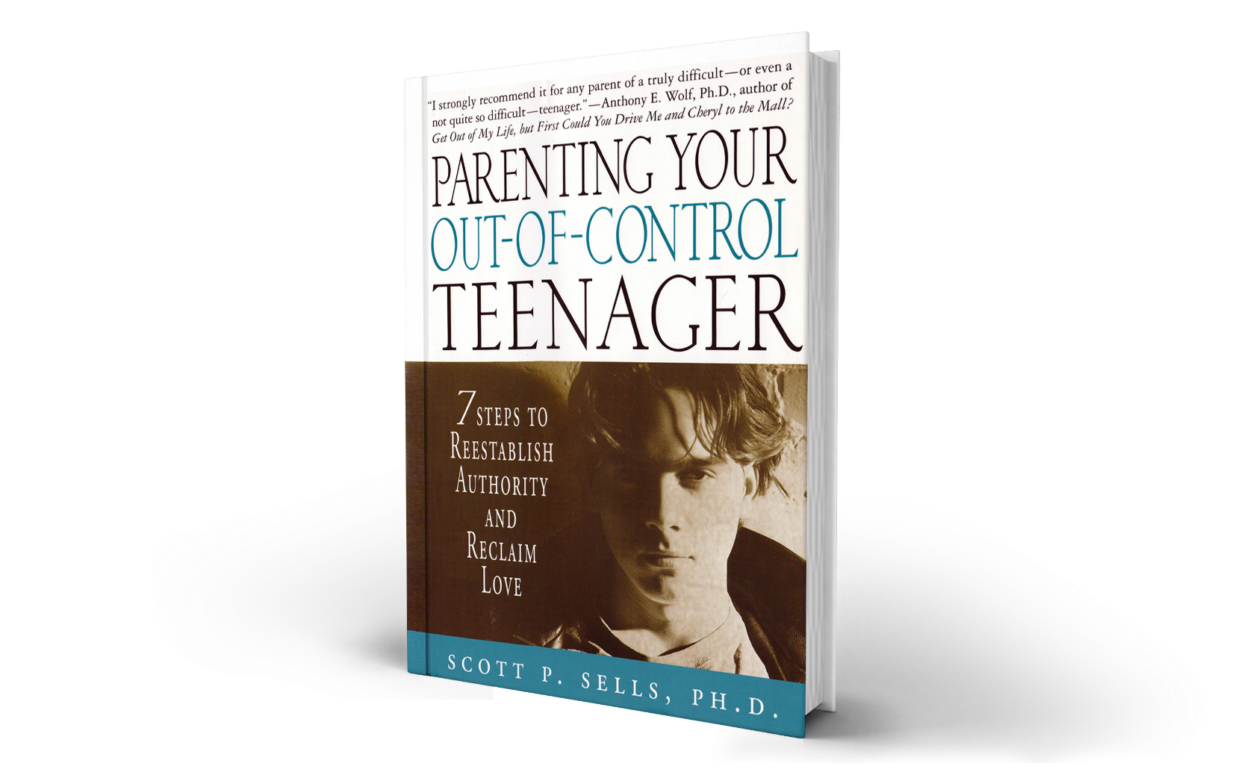


THE PLL PROGRAM IN PARTNERSHIP WITH ____________________
(Service Provider)
www.gopll.com

Slide 2
What is PLL?

Slide 3
PLL is…
Nationally recognized as an Evidence-Based Family-Systems Treatment Model
California Evidence-Based Clearinghouse (CEBC)
Promising Practices Network on Children, Families and Communities
OJJDP Model Programs Guide
Washington State Institute for Public Policy (WSIPP)

Slide 4
PLL is…
A brief, structural and strategic family therapy model
Typical Length of Treatment is 3-5 months
Treats the entire family!
Families are provided with a clear roadmap of treatment (Participation & Graduation Agreement-next slide)

Slide 5
PLL Treatment Roadmap
Notes:
Emphasize that families always know where they are in treatment with their own Participation and Graduation Agreement.

Slide 6
PLL has…
Four primary model components:
  Skills Training Therapy: providing caregivers and youth with new skills for improved family functioning
  Stabilization Therapy: restoring the parental hierarchy and establishing healthy family boundaries and roles
  Trauma Therapy: treating unresolved trauma within the family system
  Relapse Prevention: preparing the family for the “fallout” of change

Slide 7
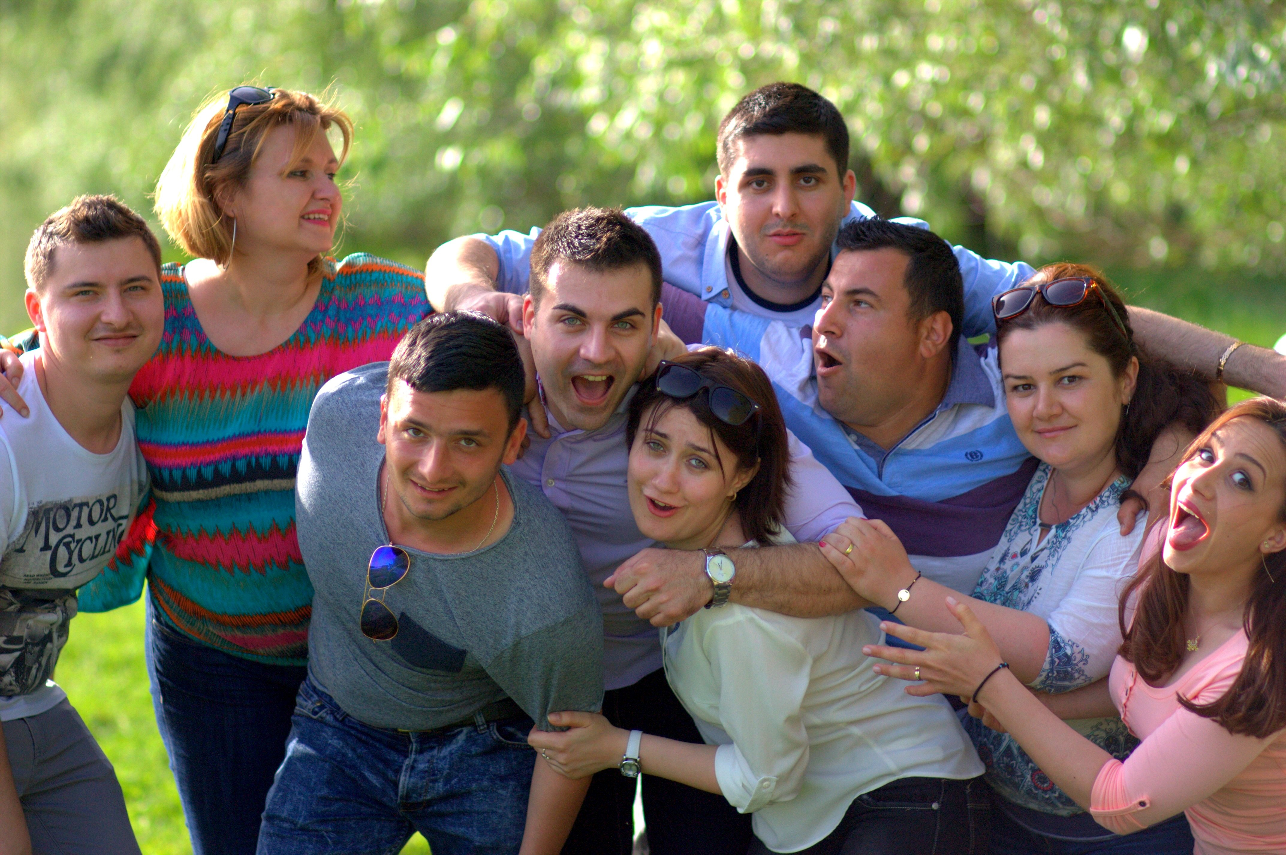

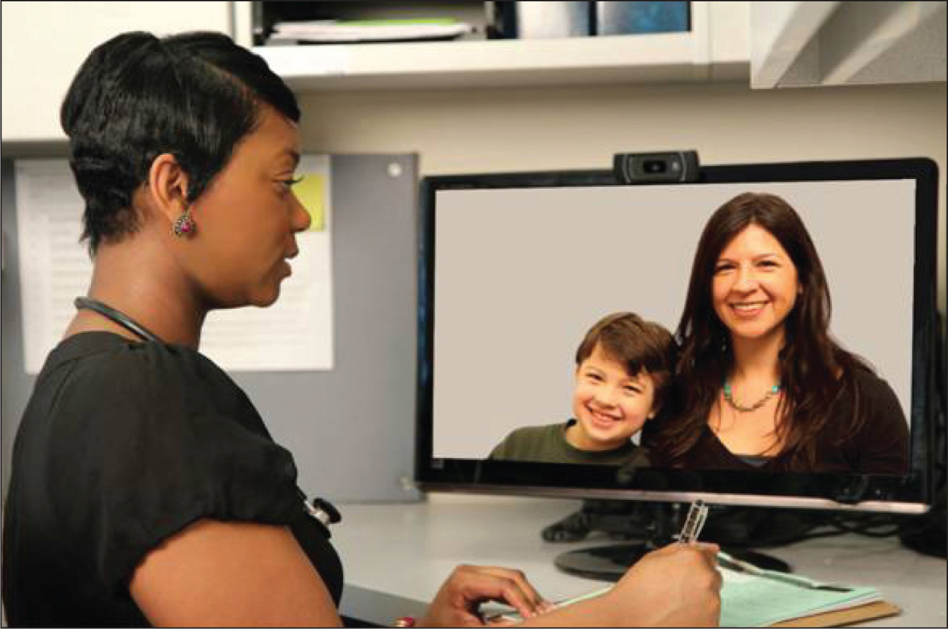
PLL has…
Three Unique Delivery Systems
Cohort Delivery
Single Family Delivery
Telehealth Delivery

Slide 8



Unique Packaging of PLL
Cohort Family Delivery System
Family Systems Stabilization Therapy
Family Systems Trauma Therapy
Relapse Prevention
Group Therapy
(Skills Training with all families together)
Motivational Interview
Family Therapy
Includes…
Brief Solution-Focused Treatment

Slide 9
PLL has…
Three Unique Delivery Systems
Cohort Delivery
Single Family Delivery
Telehealth Delivery

Slide 10
Unique Packaging of PLL
Single-Family Delivery System
Skills Training Therapy
Motivational Interview
Family Therapy
Includes…
Family Systems Stabilization Therapy
Family Systems Trauma Therapy
Relapse Prevention
Brief Solution-Focused Treatment

Slide 11
PLL has…
Three Unique Delivery Systems
Cohort Delivery
Single Family Delivery
Telehealth Delivery

Slide 12
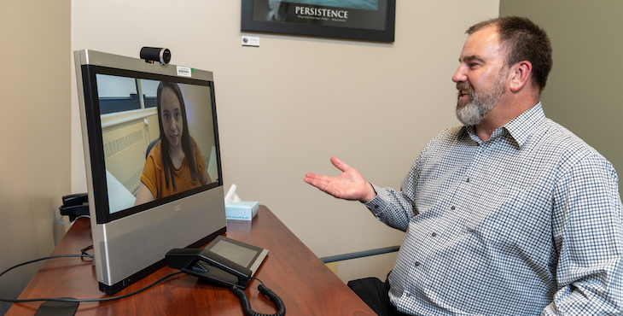
Unique Packaging of PLL
Telehealth Delivery System
Skills Training Therapy
Family Systems Stabilization Therapy
Motivational Interview
Family Therapy
Includes…
Family Systems Trauma Therapy
Relapse Prevention
Brief Solution-Focused Treatment

Slide 13


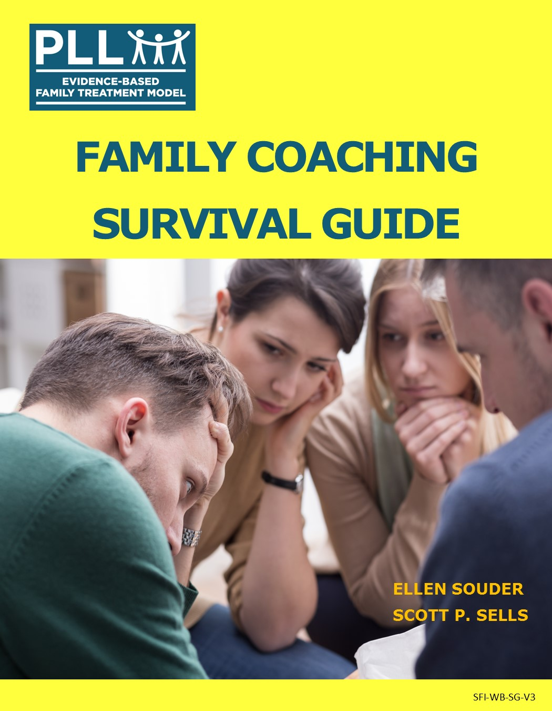
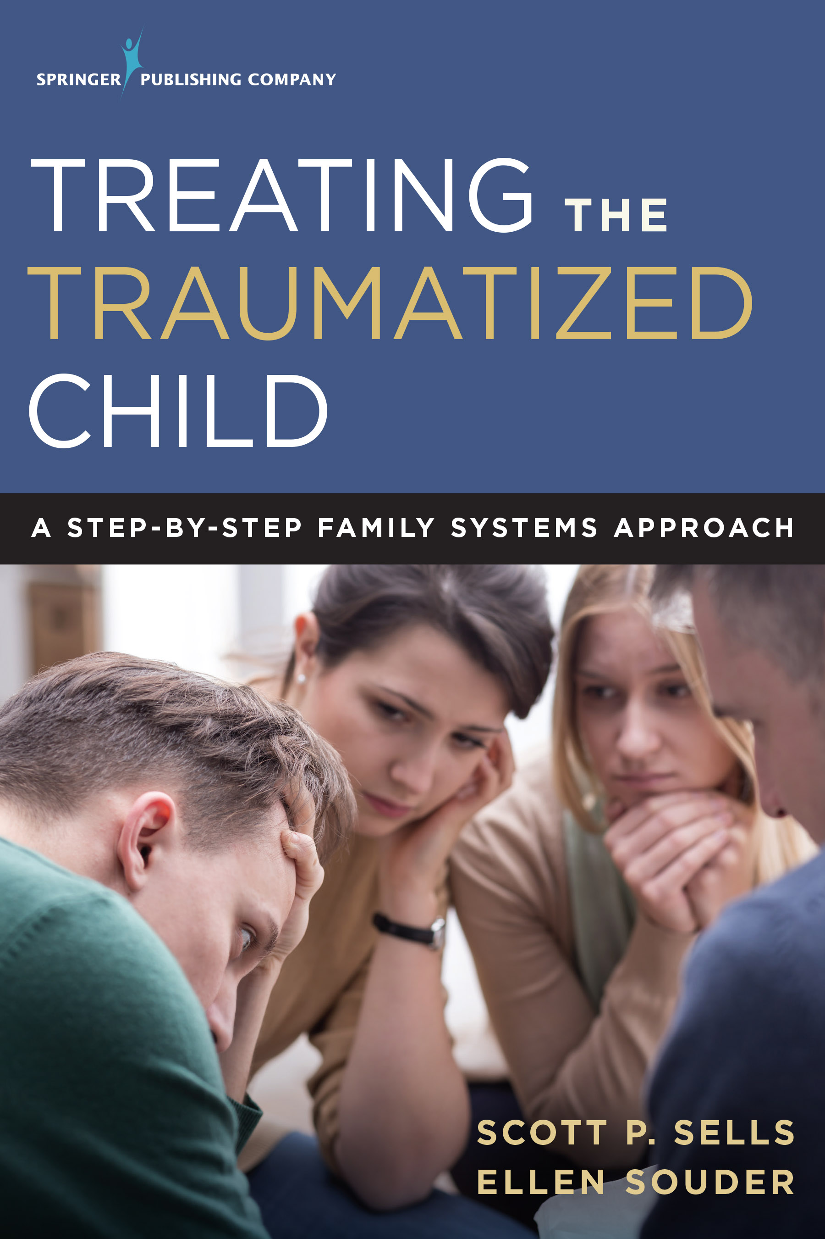

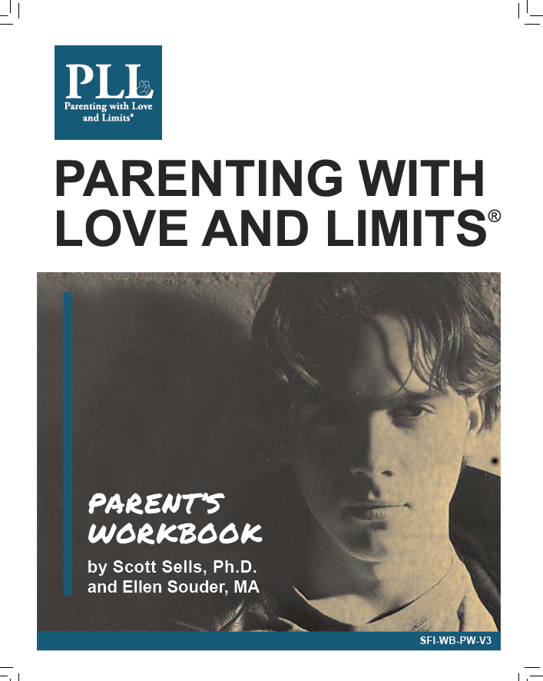
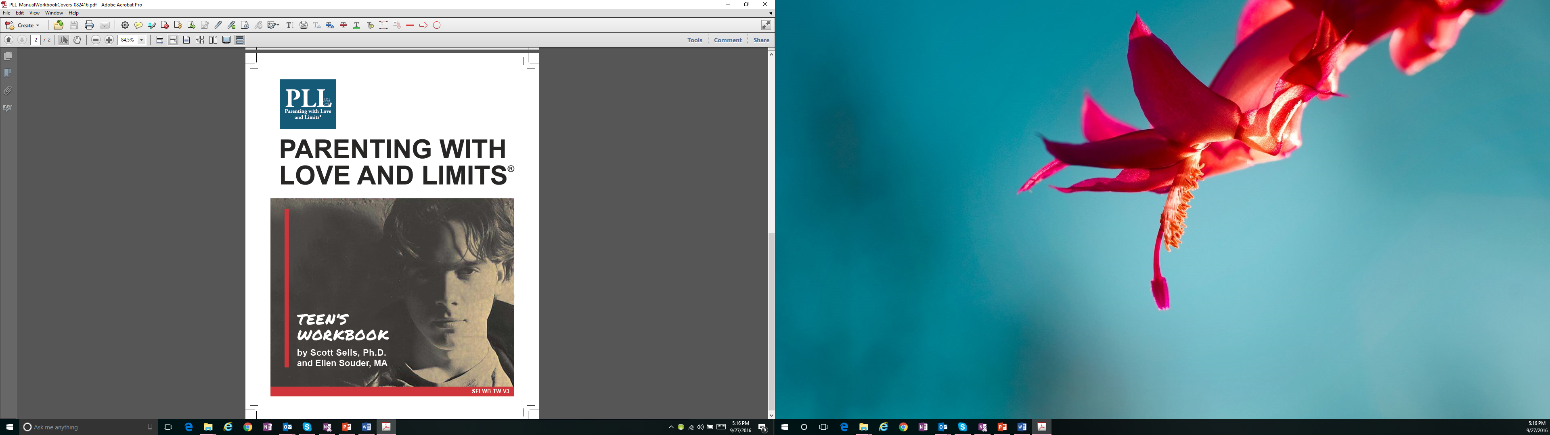
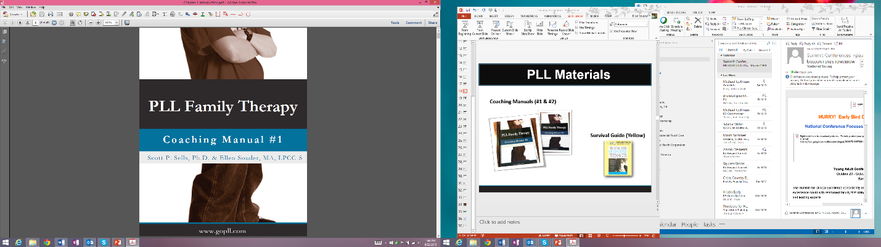
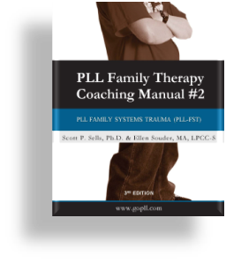
PLL MANUALIZED CURRICULUM
PLL FAMILY Materials
PLL CLINICIAN Materials
Parent Reference
Book
Parent Survival Guide
Group Manual
Skills Manual
Therapist Reference Book
Parent Workbook
Teen Workbook
Coaching Manuals
PLL Document Library Access and Power Point Slides
Family Materials Available in Spanish
Video Vignettes

Slide 14
Who should be referred to PLL?

Slide 15
PLL’s Inclusionary Criteria…
Appropriate Referrals to the PLL program:
Families with a youth between the ages of 10-18 years old
Families with a youth exhibiting emotional or behavioral problems such as depression, anxiety, substance abuse, aggression, rule-breaking, truancy, oppositional defiant and conduct disorder type behaviors
Families with a youth who have committed a sex offense IF the following conditions are met:
  The referral source must understand that PLL is NOT the sex offender treatment provider
The youth must live with a parent or caregiver
  Youth can live with a foster parent or be in kinship care
  If the youth is in a residential placement, there must be a reunification plan for the youth to return home
EXCLUSIONARY CRITERIA:
Actively psychotic clients
Actively homicidal clients
Actively suicidal clients
Caregiver or youth with an Intelligence Quotient (IQ) of less than fifty (50)
Notes:
Emphasize that it is actually “pretty hard” to be excluded from PLL treatment!

Slide 16
Why refer families to PLL?
Based on PLL’s national outcomes, you can expect the following key outcomes:
Over 70% of your referrals will be engaged
Over 70% of your engaged families will complete treatment
Annual research analysis will indicate positive change in youth behavior
Annual research analysis will indicate positive change in family communication and overall family functioning
Notes:
If desired, you can pull in the research outcomes slides from your most recent PLL annual review to illustrate the CBCL and FACES Results

Slide 17
How do I refer a family to PLL?
Next Steps:
Identify a family as an appropriate referral based on the Inclusionary Criteria (slide 15)
Complete the referral form and email to the PLL Clinician
Let the family know you are referring them to PLL and to expect a phone call from the PLL Clinician
The PLL Clinician will contact the family within 48 hours to begin the engagement process (Motivational Phone Call & Face-to-Face Motivational Intake) **Referrers are invited to attend the Motivational Intake
Notes:
Make sure you have copies of your referral forms to provide to the referral sources
Make sure that the referral source DOES NOT tell the family about the PLL program other than to say that they believe it will help them with their challenges…and that the PLL Clinician will call them to explain the program.
Let the Referrer know that it helps to engage the families if the referrer also attends the Motivational Intake

Slide 18
THANK YOU
A FAMILY SYSTEMS STABILIZATION AND TRAUMA MODEL

