Slide 1
Group 1
www.gopll.com

Slide 2
GROUP ONE
Top 6 Reasons Why
Teens Misbehave
Reason #1: Button Pushing
Reason #2: Thinking Two Steps Ahead of the Parent
Reason #3: Misuse of Outside Forces
Reason #4: Teenagers are Drunk with Power
Reason #5: The Pleasure Principle
Reason #6: Peers: Your Teen’s Second Family
2
www.gopll.com

Slide 3
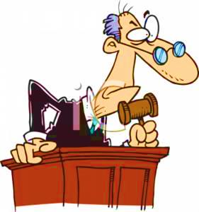
GROUP ONE
Traditional consequences are not distasteful enough to make your teen want to give up the immediate pleasure that his misbehavior currently brings him.
3
www.gopll.com

Slide 4
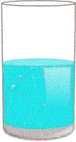
GROUP ONE
Is The Glass Half Empty Or Half Full?
“My Teenager Has a Problem, But I Can’t Fix It.”
My teenager is sick and has mental problems.
If I push too hard he will only get worse.
If I get tough I will lose my teen’s friendship
My teenager has a chemical imbalance and only needs medication to solve the problem.
My teenager has had a tough life and I feel guilty if I am tough.
My teenager will grow out of it – just hormones.
My teenager is on drugs. If I push too hard my teenager will use more drugs.
My teenager wants to be left alone and I need to respect that.
Half
Empty
4
www.gopll.com

Slide 5
GROUP ONE
Is The Glass Half Empty Or Half Full?
“My Teenager Has a Problem, and I Can Help Fix It With the Right Set of Tools.”
My teenager is stubborn or stuck in a rut.
My teenager needs parental guidance, even if he acts as if he wants to be left alone.
My teenager may have depression or
Attention Deficit Disorder (ADD) requiring some medication, but he is still accountable for any misbehavior.
My teenager is not frail. He needs consistent
structure to get stronger.
My teenager has too much power for his developmental britches.
My teen will not grow out of it on his own. It
has been over a year.
Half
Full
5
www.gopll.com

Slide 6
Group 2
www.gopll.com

Slide 7
GROUP TWO
HOT
Top 10 Parent Buttons
“You never let me do anything!”
“You don’t love me.”
“I hate you/this family!”
Swearing
“You’re not my real Mother/Father. I don’t have to Listen to you.”
A disgusted look, improper gesture or whiny voice
“I’m gonna kill/hurt you/myself/others.”
Lying
“I hate school; I’m not going!”
“I’m going to leave or run away.”
7
www.gopll.com

Slide 8
GROUP TWO
HOT
Top 8 Teen Buttons
Preaching or nagging
Talking in chapters
Labeling
Futurizing
Instant problem-solving
You get moody sometimes
Not letting you experiment
Collecting criticisms
8
www.gopll.com

Slide 9
GROUP TWO
First Dance Move
Your teen made the first dance move by
______________________________ on you.
(Name button pushed here)
Second Dance Move
This made you, the parent, angry and frustrated.
You then made the second dance move by ______________________________ to your
(Name button used here)
teenager. This started to pour gasoline on an already lit fire! Your teen may have added to the fire by rolling his eyes or making faces.
9
www.gopll.com

Slide 10
GROUP TWO
Third Dance Move
Your teen then makes the third dance move by pushing even more of your buttons, such as: ______________________________.
At this point, you begin to lose control of your emotions. You swear, you get angry, you shut down, you storm out, etc.
Fourth Dance Move
Your teen smiles in victory because they just played the game better than you did. They controlled your mood and clouded your judgment. You then became a fish on their string, and you were reeled on in for dinner.
10
www.gopll.com

Slide 11
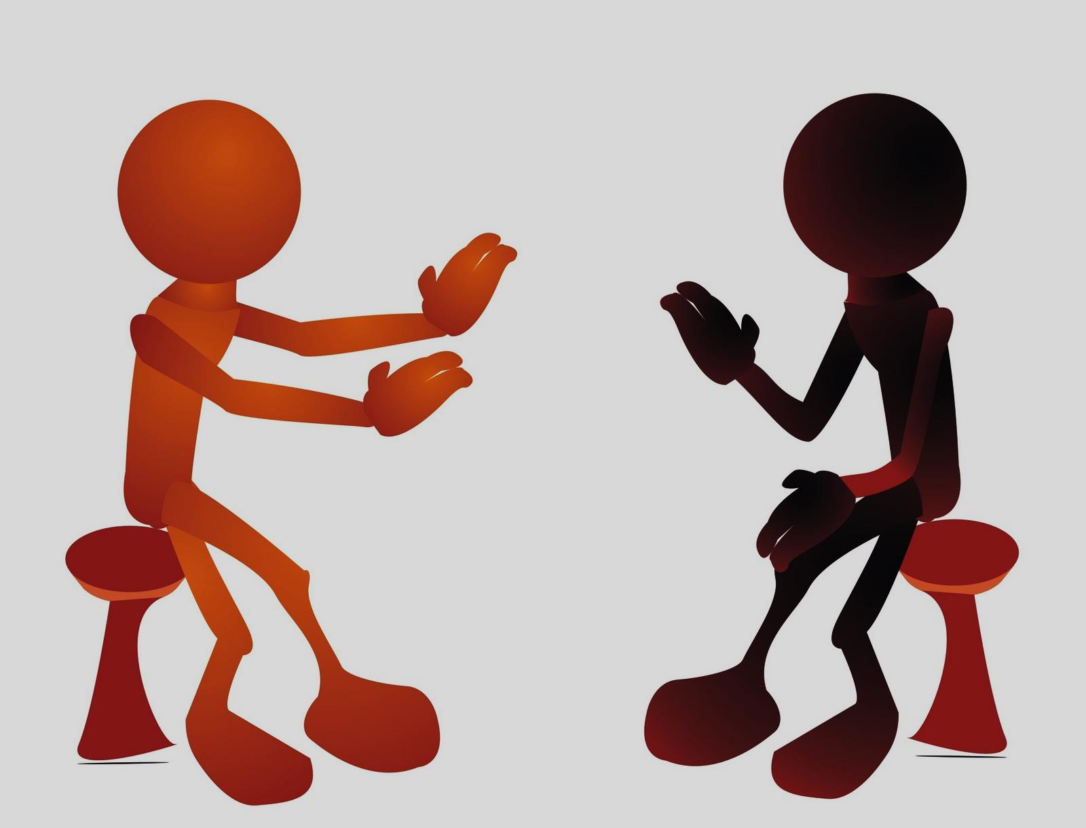
GROUP TWO
# 1 Arguments Are Not Won
Based on Who is Bigger or
Stronger than the Other. #2 Arguments Are Won
Based on Whoever is Better at the Game of
Controlling the Mood of the
Other Person and the
Direction of the Argument.
11
www.gopll.com

Slide 12
GROUP TWO
5 Button Buster Strategies
Separate From Personal Attacks
Exit and Wait
Button pushing is not personal. The real intent is to get you to let them go to a party, back down on a punishment, or leave them alone.
The best thing about this strategy is that by saying nothing, you never have to take back harsh words or criticisms said in anger.
Short and To The Point
Using Reflectors
Create Secret Signs
Lecturing or offering long explanations only gives your teenager the upper hand to push your buttons and achieve victory.
“Reflectors” are words or phrases like "nevertheless," "regardless,“ or "that is the rule.” They help you redirect the conversation back to the issue at hand.
Together, you can develop a set of secret signs or "Morse Codes" to quietly signal one another that your teen is skillfully pushing your buttons or that it is time to exit and wait.
12
www.gopll.com

Slide 13
GROUP TWO
“You never let me do anything!”
This statement invites you to point out
specific times that you have
let your teenager do what he wanted.
Underlying Motives:
To force you off the real issue at the
moment and give your teen the
upper hand in the discussion.
13
www.gopll.com

Slide 14
GROUP TWO
“You don’t love me.”
Unfortunately, many parents take this bait instead of recognizing that asking their teen to do something he does not like has nothing to do with love. Parents often have to administer medicine that may taste bad, but is necessary for growth/healing.
Underlying Motives:
This statement is intended to induce guilt and make the parents question their own self-worth so that they will back down
14
www.gopll.com

Slide 15
GROUP TWO
3) “I hate you/this family!”
This button makes you feel bad and causes hurt feelings.
Underlying Motives:
These statements are meant to hurt your feelings, cloud your thinking, and limit your ability to effectively enforce consequences.
15
www.gopll.com

Slide 16
GROUP TWO
5 Button Buster Strategies
Separate From Personal Attacks
Exit and Wait
Button pushing is not personal. The real intent is to get you to let them go to a party, back down on a punishment, or leave them alone.
The best thing about this strategy is that by saying nothing, you never have to take back harsh words or criticisms said in anger.
Short and To The Point
Using Reflectors
Create Secret Signs
Lecturing or offering long explanations only gives your teenager the upper hand to push your buttons and achieve victory.
“Reflectors” are words or phrases like "nevertheless," "regardless,“ or "that is the rule.” They help you redirect the conversation back to the issue at hand.
Together, you can develop a set of secret signs or "Morse Codes" to quietly signal one another that your teen is skillfully pushing your buttons or that it is time to exit and wait.
16
www.gopll.com

Slide 17
GROUP TWO
ULTIMATE SECRET WEAPON
BUTTON BUSTER
BEING PREDICTABLE!!
UN
17
www.gopll.com

Slide 18
Group 3
www.gopll.com

Slide 19
What a Well Written Contract Looks Like
GROUP THREE
Trisha’s and Dad’s Contract
Trisha’s behavior will be considered disrespectful if she does any of the following:
Swears or uses (2) Refuses to go to her
obscene gestures like room to cool down
giving the finger. on her own or after
one warning from
either parent.
Reward
If Trisha goes 7 straight days with no disrespect, she will get a coupon for two extra hours of phone time to be used anytime she is not grounded.
Consequence
If either #1 or #2 occurs, Trisha will be grounded both Friday and Saturday nights. If she is disrespectful again that same week, then she will be grounded the next weekend, and so on.
Dad’s Role
Dad will ask Trisha at least one time a day (with the TV off) how her day was. He will also listen and not interrupt Trisha until she finishes her sentence.
If Dad interrupts or forgets to talk to Trisha, she has the option of giving Dad at least three good squirts of water anywhere but the face. _________________ _______________
Trisha’s Signature Dad’s Signature
19
www.gopll.com

Slide 20
GROUP THREE
Top 5 Reasons Why Your Current Contracts Fail
Reason #1: Teens Have “Literal Disease
Reason #2: Rules Optional, Not Mandatory
Reason #3: Too Many Rules At One Time
Reason #4: Consequences Not Predetermined
Reason #5: Lack of Troubleshooting
20
www.gopll.com

Slide 21
GROUP THREE
Regina’s curfew time will be 5pm on school nights (Sunday through Thursday) and 10pm on weekends (Friday & Saturday).
If Regina returns home past her curfew hour, she will be considered late.
21
www.gopll.com

Slide 22
GROUP THREE
Comparison of Regina’s Contract
NOT IRONCLAD
IRONCLAD
Regina’s curfew time will be 5pm on school nights (Sunday through Thursday) and 10pm on weekends (Friday & Saturday). If Regina returns home past her curfew hour, she will be considered late.
Regina will be considered late if she is one minute past 5pm on weekdays (Sunday through Thursday) or 10pm on weekends (Friday & Saturday) according to our kitchen clock. She must be physically inside the house & must notify us (the parents) that she is home to be considered on time. These times will not be changed or altered until we as parents decide otherwise. Therefore, Regina’s trying to change them on her own also breaks this rule.
22
www.gopll.com

Slide 23
GROUP THREE
Top 5 Reasons Why Your Current Contracts Fail
Reason #1: Teens Have “Literal Disease
Reason #2: Rules Optional, Not Mandatory
Reason #3: Too Many Rules At One Time
Reason #4: Consequences Not Predetermined
Reason #5: Lack of Troubleshooting
23
www.gopll.com

Slide 24
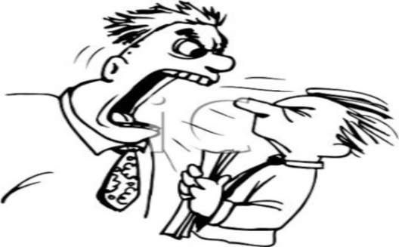
GROUP THREE
75% of all your arguments with your teen are because you lecture or argue over what the rules and punishments are.
24
www.gopll.com

Slide 25
GROUP THREE
Top 5 Reasons Why Your Current Contracts Fail
Reason #1: Teens Have “Literal Disease
Reason #2: Rules Optional, Not Mandatory
Reason #3: Too Many Rules At One Time
Reason #4: Consequences Not Predetermined
Reason #5: Lack of Troubleshooting
25
www.gopll.com

Slide 26
GROUP THREE
KNOW YOUR
PLAYING FIELD
Church, Friends, or Extended Family Peers: Your Teenager’s Second Family Child Protective Services (CPS) and Police Officers Other Counselors, Probation Officers, of Psychiatrists School: Your Teenager’s Backyard Co-Workers, Bosses, and Your Job
26
www.gopll.com

Slide 27
Group 4
www.gopll.com

Slide 28
GROUP FOUR
Top 10
Areas Teens Care About
1) Money 2) Telephone 3) Freedom 4) Clothing 5) Cars
6) Loosened Restrictions 7) Trust 8) Appearance 9) Material Objects 10) Spending Time
28
www.gopll.com

Slide 29
Group 5
www.gopll.com

Slide 30
GROUP FIVE
Positive Teen Report
For: ______________________________________
___ Academics ___ Athletics ___ Creativity
___ Concern for others ___ Performed well under stress
___ Did chores without being asked ___ Avoided an argument
___ Job Performance ___ Respectful ___ Other
I
Saw
It!
You
Did
It!
You are being recognized for going beyond the call of duty!
Keep moving forward! You’re fantastic!
____________________________________ ____________________
Parent’s Signature Date
30
www.gopll.com

Slide 31
Group 6
www.gopll.com

Slide 32
GROUP SIX
Did it look like the boy had plenty of structure, limits, and discipline?
Why was this not enough?
What was missing?
32
www.gopll.com

Slide 33
GROUP SIX
Do you believe the latest research that states:
A child or teen’s misbehavior is as much connected to a lack of limits as it is to a lack of love and nurturance between parent and child.
33
www.gopll.com

Slide 34
GROUP SIX
The Big Chill Timeline
STAGE 1
Behavior Problems
A preadolescent or early adolescent becomes rebellious and has behavior problems.
STAGE 2
Negative Interaction
The child fails to comply with parental requests and lecturing & negative interaction jumps to 90-100% of the time.
STAGE 3
Conditional Love
Special outings or signs of affection then become contingent on how good the behavior was each week.
STAGE 4
Emotional Deprivation
Sets in when the parents and teen stop physical affection and special outings. Everyone feels so burned out that they stop trying.
34
www.gopll.com

Slide 35
GROUP SIX
The Big Chill Timeline
STAGE 5
Second Family Takes Over
If teenager does not receive nurturance in the family, he will look to an adopted "second family" of peers, gangs, or drugs.
STAGE 6
Parent & Teen Stuck In a Vicious Cycle
As parents see the teenager pull away, they will lecture or impose more rules, which in turn will push the teenager further away until both parties get stuck in a rut and are unable to make the first move to break down the walls of emotional deprivation.
STAGE 7
Teen Hardened & Lacks Empathy
As this rut continues, the teenager becomes more and more hardened. Over time the teenager develops an inability to show remorse or empathy and may even develop an antisocial personality disorder.
35
www.gopll.com

Slide 36
GROUP SIX
Timing is Everything
Option #1: The Soft Side Before The Tough Side | Option #2: Address Both Toughness and Softness at the Same Time | Option #3: Address the Tough Side First
The problem behaviors are minimal Negative interaction or arguments don’t occur any more than 25% of the time. You are not burnt out and do not feel bitterness towards your teen This option works best with younger children who are just starting to act out | The problem behaviors have begun but not yet persisted for 6 months or more Negative interactions have not yet exceeded 50% of the time If things don’t change, you are about to into Stage 2 or higher on the Big Chill Timeline | Months or years have taken their toll on your parent/teen relationship Negative interactions occur more than 50% of the time You are officially in Stage 2 or higher on the Big Chill Timeline Nurturance cannot be addressed until the “bleeding” has stopped
36
www.gopll.com

Slide 37
GROUP SIX
Healing
Phrases
1. I Can’t Change the Past, But I Can Change the Future. 2. Life is a Big Do Over.
I Have the Choice to Re-Write History.
37
www.gopll.com

Slide 38
GROUP SIX
“Rules Without a Nurturing Relationship with You (the parent) Leads to Rebellion in Your Child”
38
www.gopll.com

Slide 39
GROUP SIX
Toxic Behaviors that Poison your Relationship with your Teenager
#1: Bringing up the past
#2: Attacking the person rather
than the Misbehavior
#3: Compliment Sandwiches
#4: You must first be good to get
my love
#5: No opportunities to regain trust
39
www.gopll.com

Slide 40
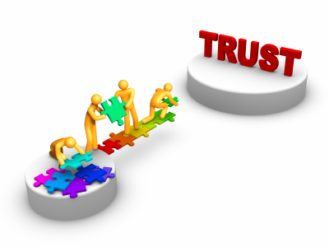
GROUP SIX
7 Strategies to Restore Nurturance
#1 Education and Normalization
#2 Opportunities to Earn Trust
#3 A New Approach to Criticism
#4 Emotional Warm-Ups
#5 Acceptance of Underlying Feelings
#6 Physical Touch
#7 Special Outings
40
www.gopll.com

Slide 41
www.gopll.com

