Slide 1
Who should be referred to PLL?

Slide 2
PLL’s Inclusionary Criteria…
Appropriate Referrals to the PLL program:
Families with a youth between the ages of 10-18 years old
Families with a youth exhibiting emotional or behavioral problems such as depression, anxiety, substance abuse, aggression, rule-breaking, truancy, oppositional defiant and conduct disorder type behaviors
Families with a youth who have committed a sex offense IF the following conditions are met:
The referral source must understand that PLL is NOT the sex offender treatment provider
The youth must live with a parent or caregiver
Youth can live with a foster parent or be in kinship care
If the youth is in a residential placement, there must be a reunification plan for the youth to return home
EXCLUSIONARY CRITERIA:
Actively psychotic clients
Actively homicidal clients
Actively suicidal clients
Caregiver or youth with an Intelligence Quotient (IQ) of less than fifty (50)
Notes:
Emphasize that it is actually “pretty hard” to be excluded from PLL treatment!

Slide 3
Why refer families to PLL?
Based on PLL’s national outcomes, you can expect the following key outcomes:
Over 70% of your referrals will be engaged
Over 70% of your engaged families will complete treatment
Annual research analysis will indicate positive change in youth behavior
Annual research analysis will indicate positive change in family communication and overall family functioning

Slide 4
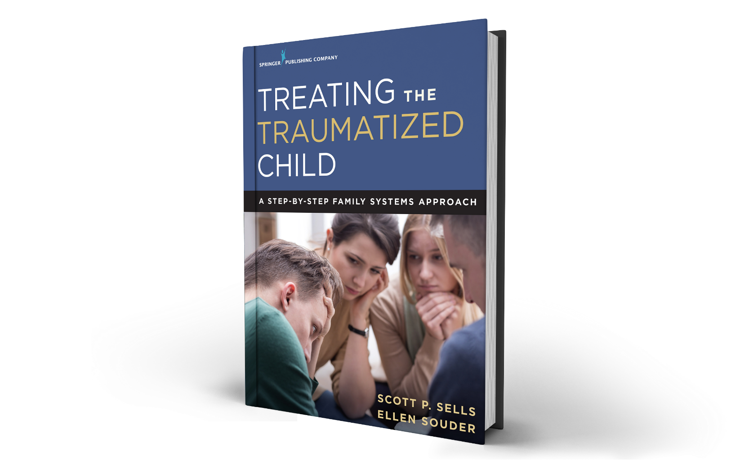
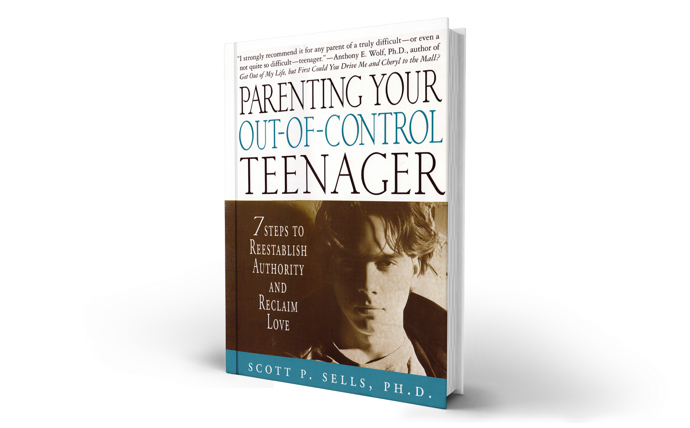
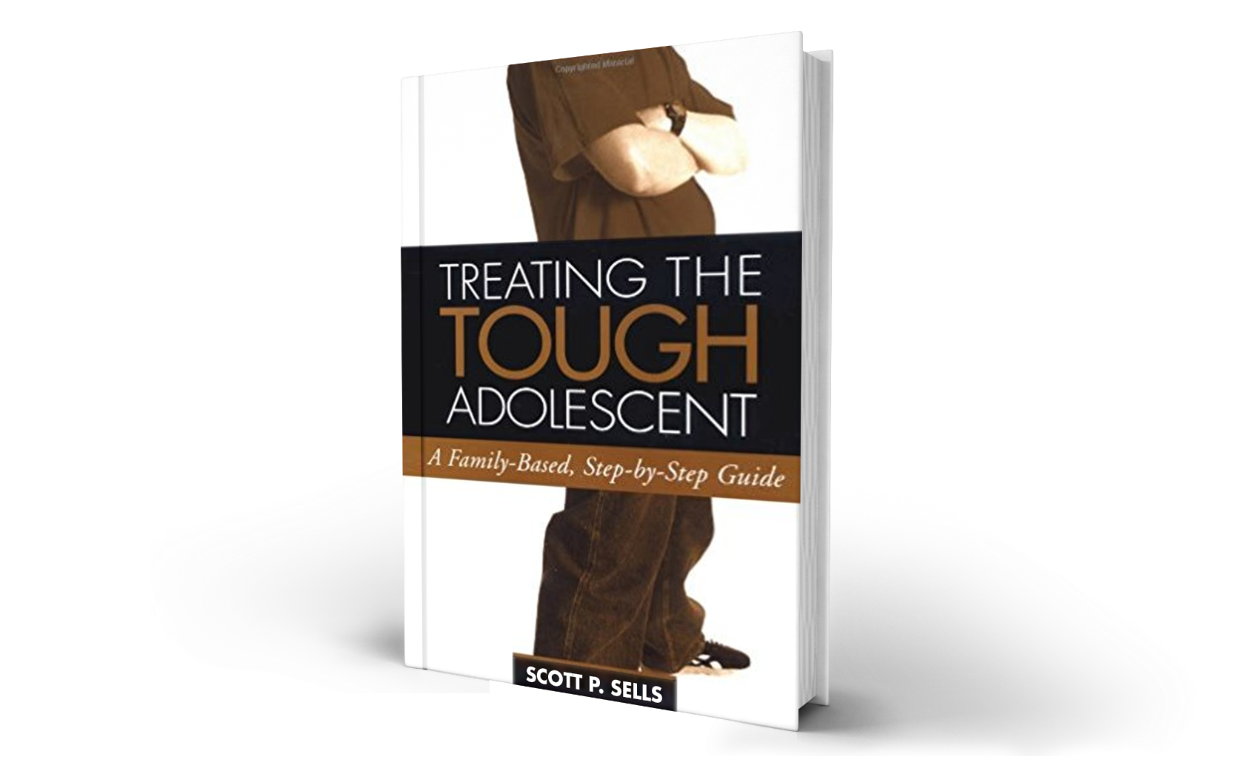
THANK YOU
A FAMILY SYSTEMS STABILIZATION AND TRAUMA MODEL

